Slide 1
L10N
Localization Basics
Tia Oniani

Slide 2

Whaaaat?
Globalization and Localization
GLOBALIZATION means cleaning up your document from all cultural references so that the document in effect becomes “cultural-less”. This, for example, would be stripping away all metaphors and idiomatic expressions from the source language that would not translate accurately.
LOCALIZATION means translating the source language of the document to the local language in such a way that original cultural references would be replaced by local cultural references and expressions that carry the same meaning.

Slide 3
L10N
Why Localize?
Market expansion
Sales growth
Customer satisfaction
Risk reduction

Slide 4

L10N
But How?
Build a plan that helps the process run smoothly
and generates a positive outcome.
Find resources:
Onsite or outsourced/agency?
Define workflow elements:
Consistency
Document streamlining
Do some prep work:
Create Glossaries and Style Guides

Slide 5
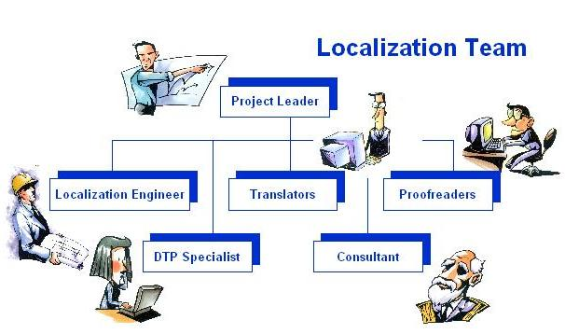
L10N
Behind the Scene…
Client
Translation Agency
Translation Agency
Linguists/
Contractors

Slide 6



L10N
Avoid country-specific information. For example, “800” telephone numbers.
Avoid abbreviations and acronyms wherever possible. They can be confusing to both your reader and your translator.
Before using acronyms, first create an acronym definition list. You can use the list while localizing, or include it as a separate appendix to your document.
Do not use upper-case letters to emphasize a particular action;
Avoid slang, and buzzwords.

Slide 7
L10N
Avoid gender-specific words. Avoid “he, she/ his, her” and use “they/ their” instead. (Be sure to make the corresponding noun plural, to avoid creating a grammatical error.)
Be aware of language expansion and leave appropriate white space. (extra 30 percent of space to account for the differences in languages);
Provide all artwork, including illustrations, photos, and other graphic components of your source file;
Most importantly, work in partnership with your vendor to provide resources and reference materials, and work through solutions and review your processes. The more you communicate with your vendor, the better job they can do for you.

Slide 8

Remember!!
Localization may be different, even when the target language is the same.

Slide 9
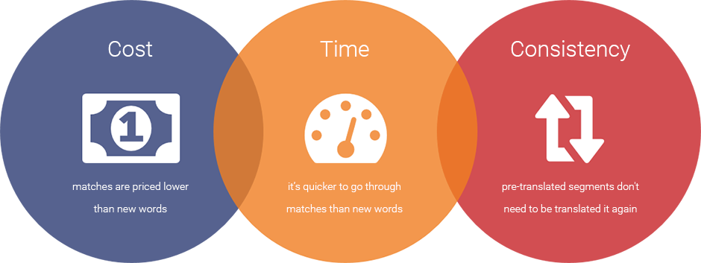
L10N
How To Save Some Money?
Think about formatting consistency
Monitor Your Word Count
The cost of localization is directly related to the number of words you write;
Use Repetitions in Your Documentation
The cost of localization can also be lowered by including repetitions in your documentation.

Slide 10
L10N
Questions?

